Slide 1
BARC Tube Bending Week 9

Slide 2
Checklist
Process: Manual Edge detection Smoothing edges Fitting lines to straight sections Angle Calculation Part 1 ( Bends 1 & 2) Part 2 ( Bends 2,3 & 4) Automated Edge detection Smoothing edges Fitting lines to straight sections Angle Calculation Part 1 ( Bends 1 & 2) Part 2 ( Bends 2,3 & 4) | Varying Parameters: Background Color Background Brightness Distance to LED box Height of camera Camera Orientation Lighting (Front vs Back) Different cameras/lenses Adding noise (non-ideal lighting conditions) No. of Cameras

Slide 3
2.4 Last week’s results
Longer sections give less variability in error
All point method is more reliable than 2 point method
Experiment setting also introduce errors. Might be tube orientation, camera placement, lighting, etc.
Log(error) vs length of section could be linear
Smaller distance between camera and tube gave smaller errors in angle calculation (13in vs 21 in)

Slide 4
Current Week Effort
Taking multiple pictures of the bend (without altering any other parameters) and checking if some random error is affecting angle calculation
Checking if changing orientation of tube is a source of error

Slide 5
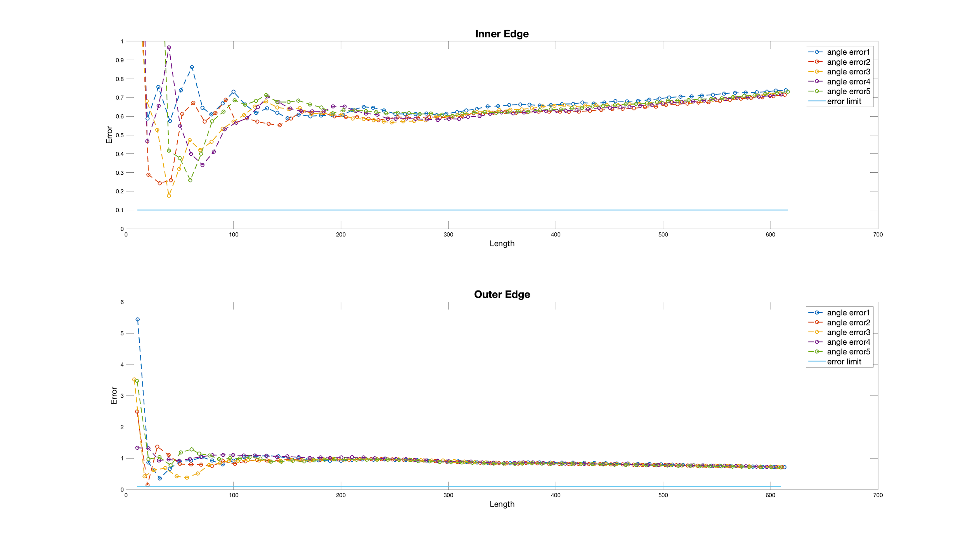
Results of capturing bend multiple times
Max difference
Inner edge: 0.0236
Outer edge: 0.0176

Slide 6
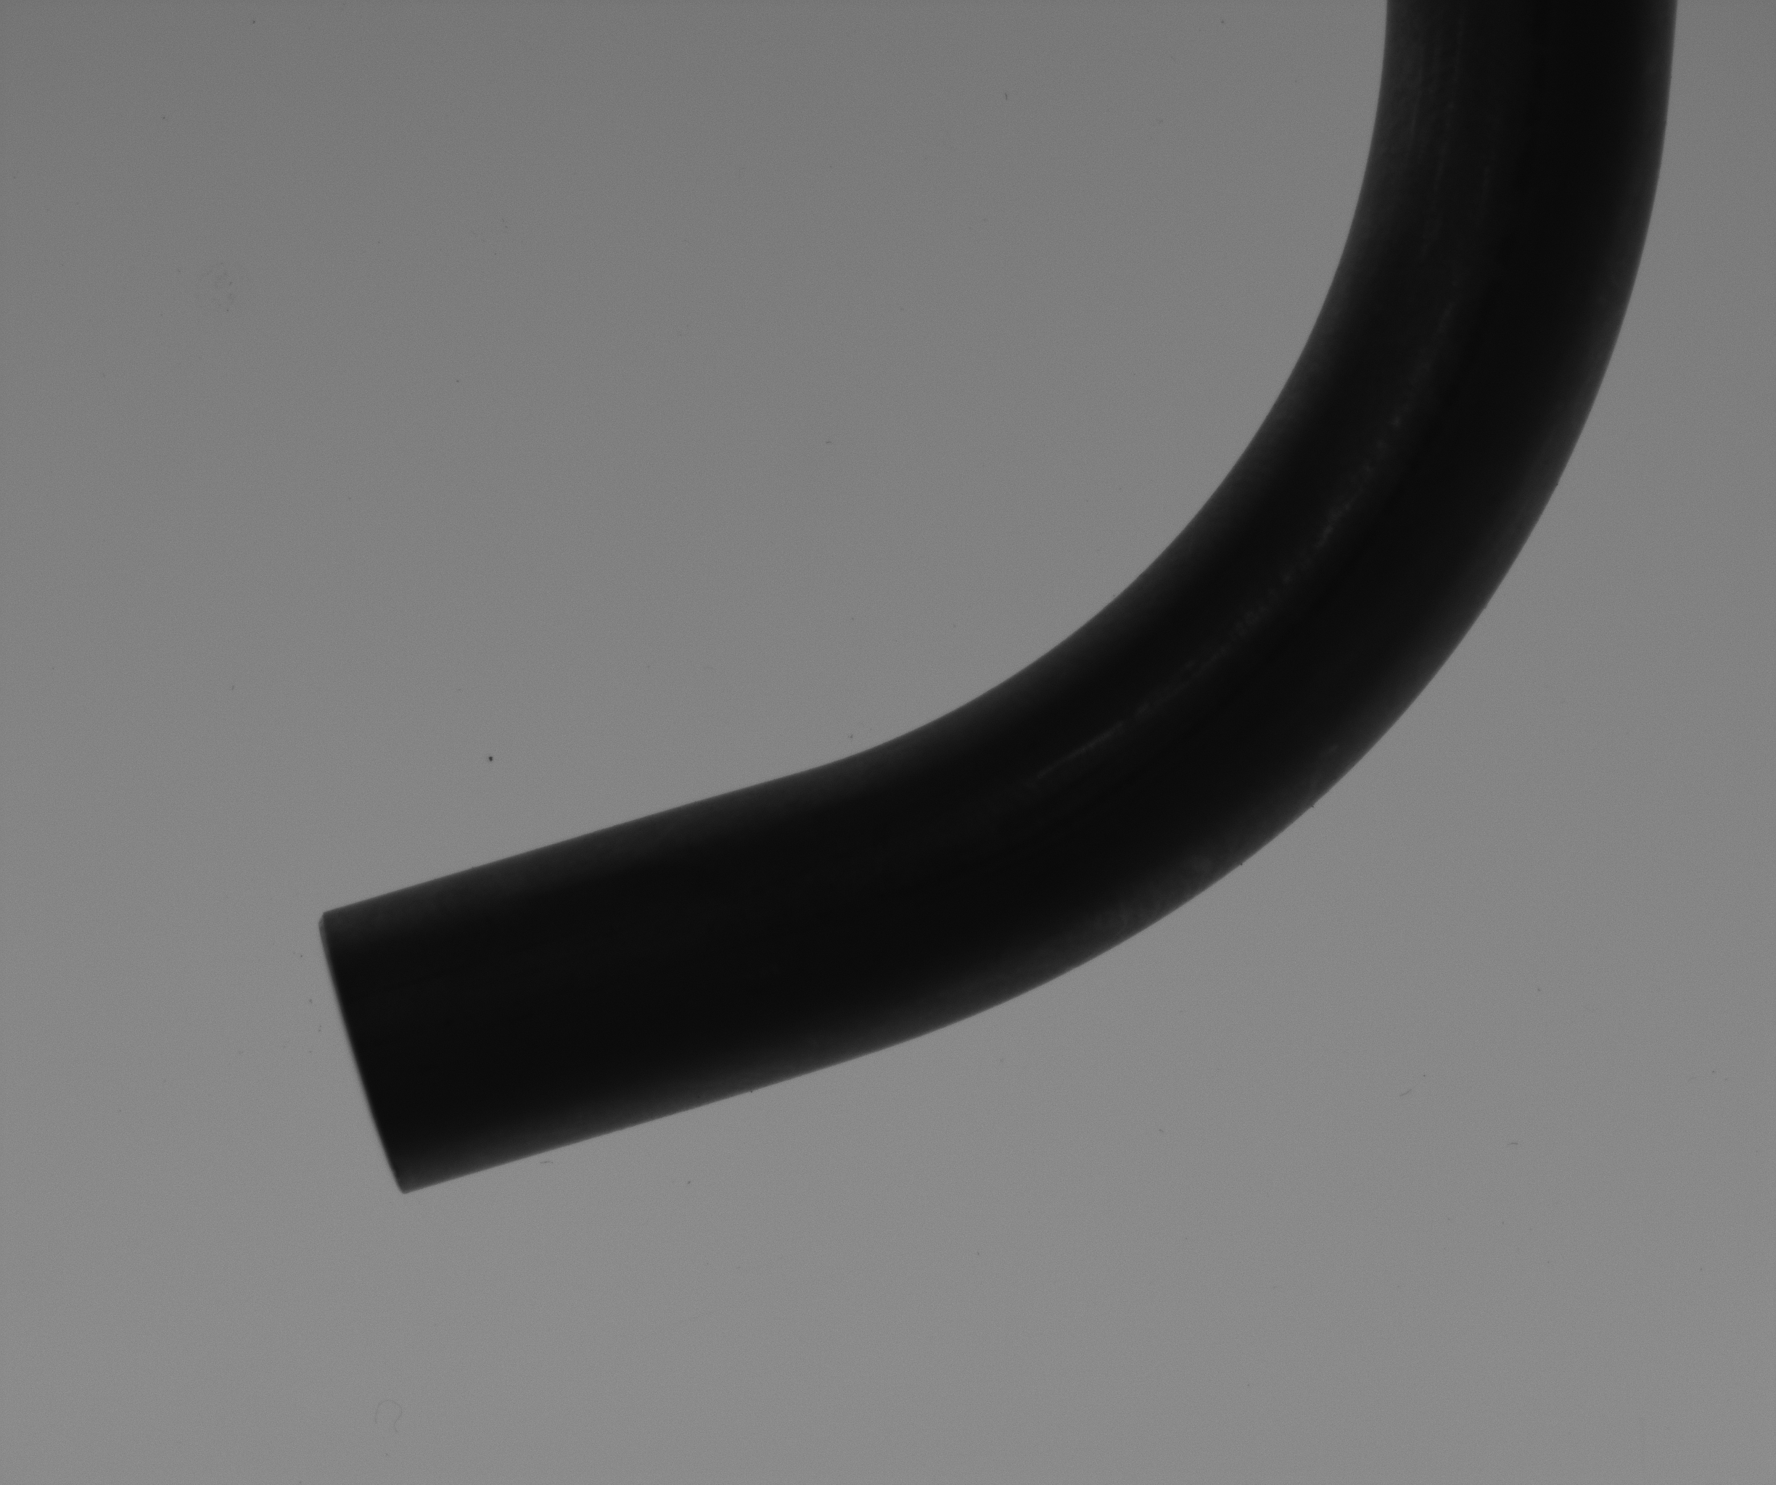
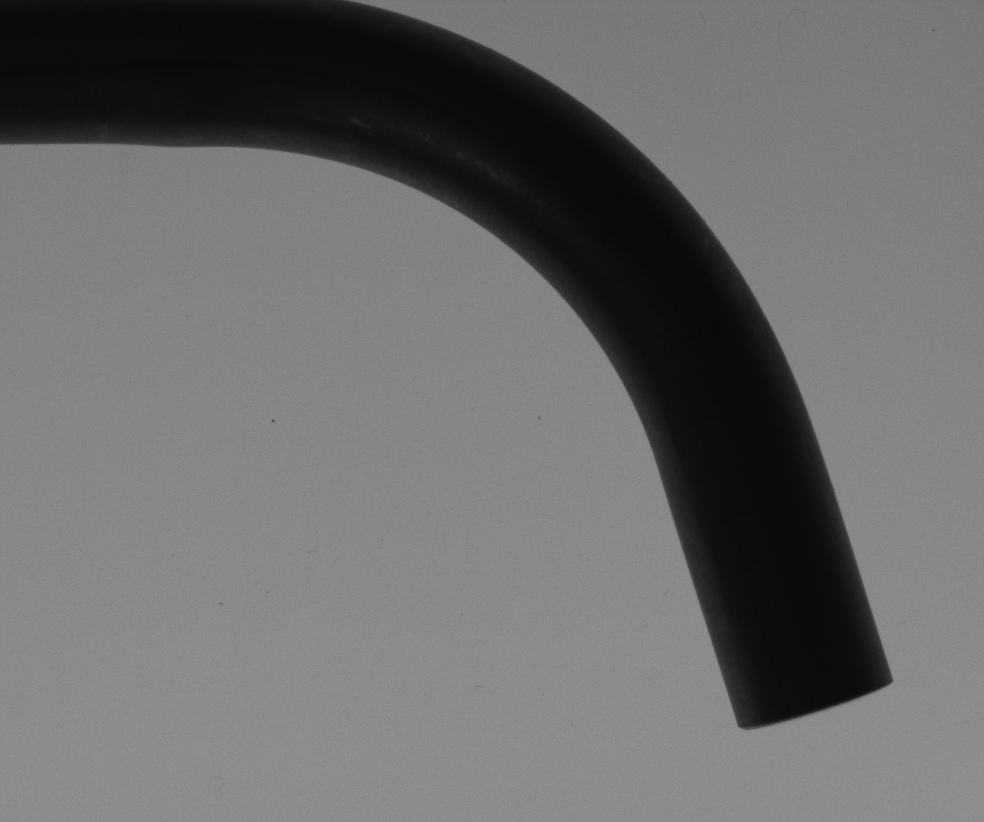
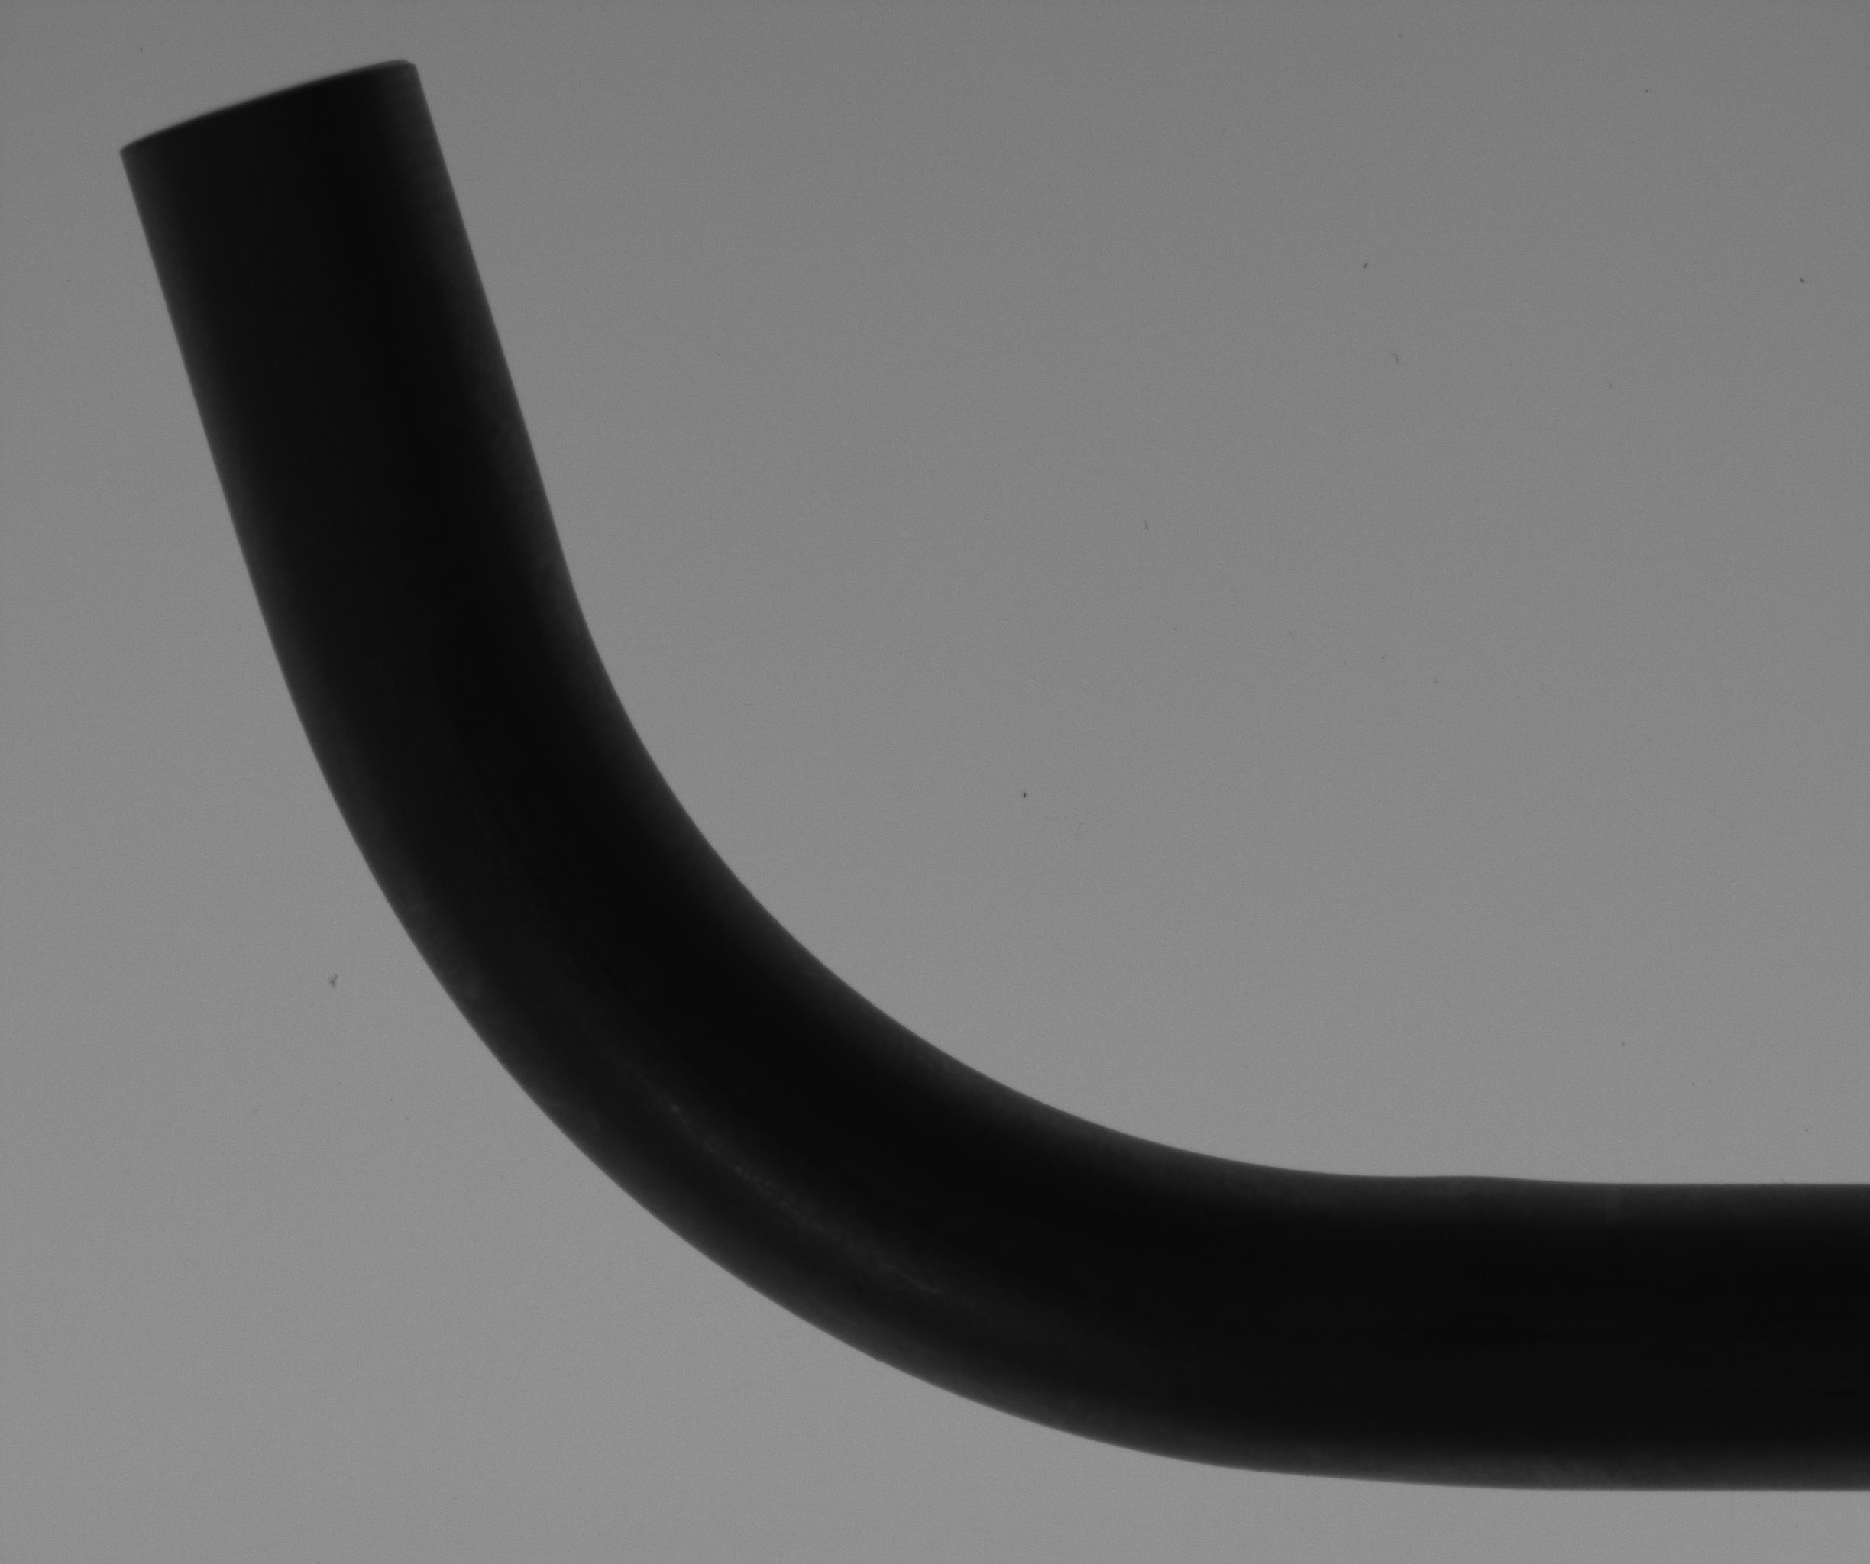
Changing Orientation : Orthogonal angles
Orient 1
Orient 2
Orient 3

Slide 7
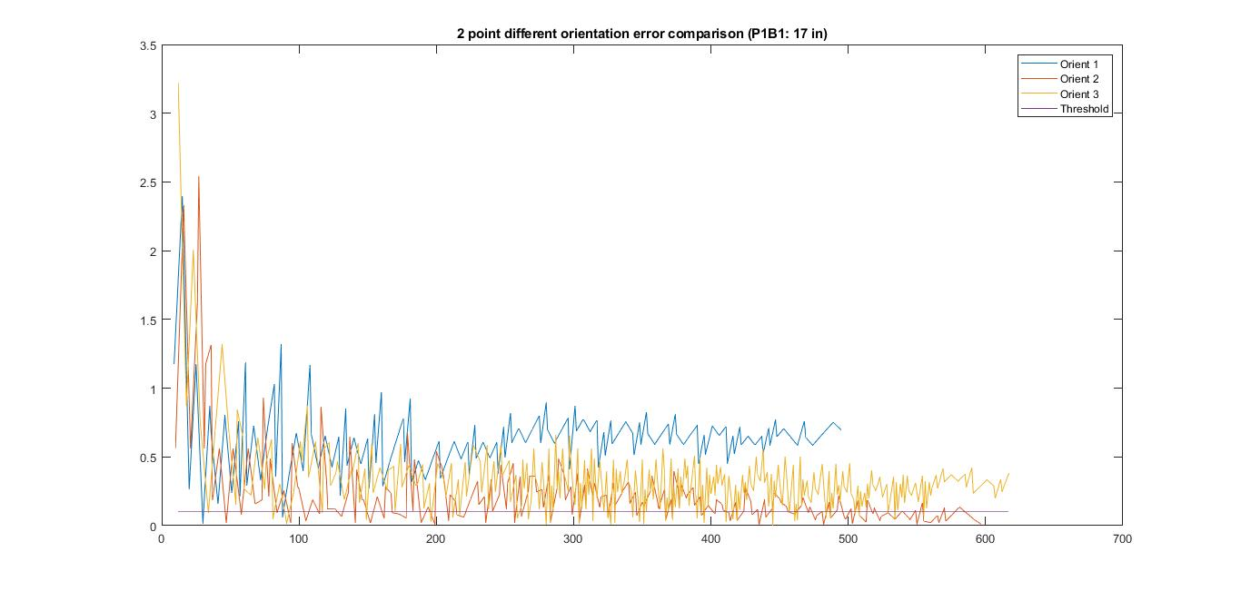
Results of changing orientation: 2 point fit
2 point fit
Error diference goes upto around 0.5
A particular orientation leads to smaller error than other

Slide 8
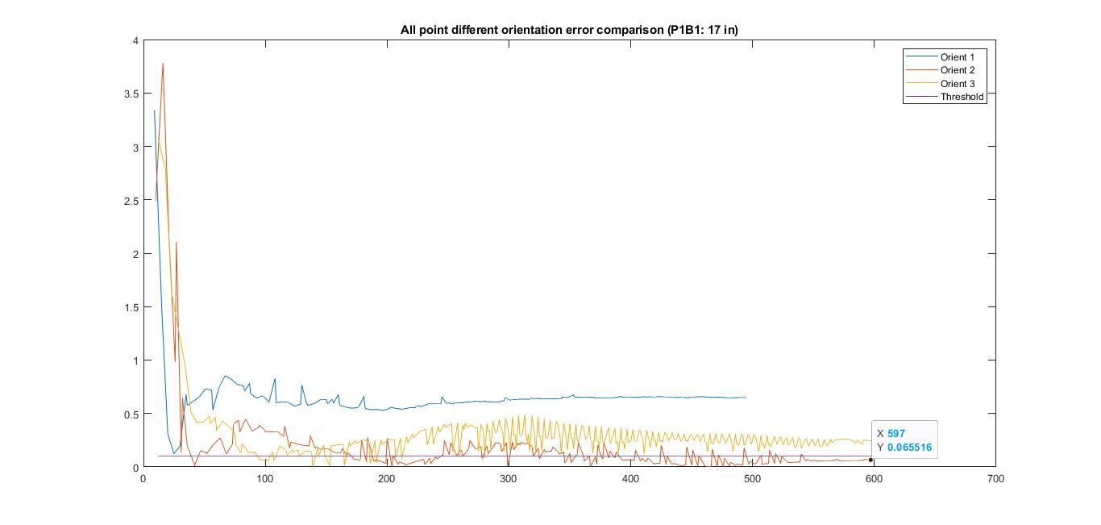
Results of changing orientation: All point fit
All point fit
Again, all point fit is more robust compared to 2 point fit. Better for analysis

Slide 9
Insights
Orientation could also be a source of error in angle calculation and can lead to an error of around 0.5 degrees
Additionally, a method of changing lightbox distance from bend sample and/or camera needs to be manufactured.

Slide 10
Current Week Effort (Continued)
Quantifying the “Jaggedness” of each edge
Calculating angles from pictures captured using a 20MP camera and quantifying their Jagedness

Slide 11
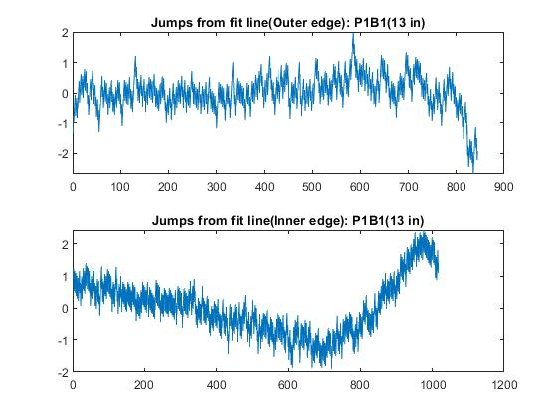
Results of Quantifying “Jaggedness” (2K)
A line is fit through all the points of the edge and each pixel point is subtracted from the line point to obtain jumps.
We observe that the jumps remain fairly constant for one of the two edges and are within a bandwidth of 2 data points (± 1).

Slide 12
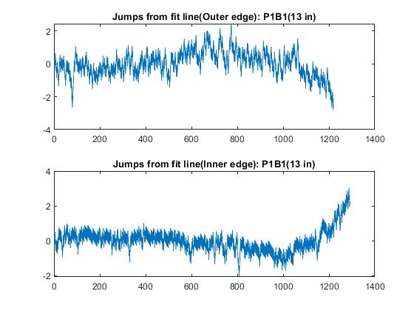
Results of Quantifying “Jaggedness” (4K)
Not much difference in jaggedness behaviour when the 20MP camera was used

Slide 13
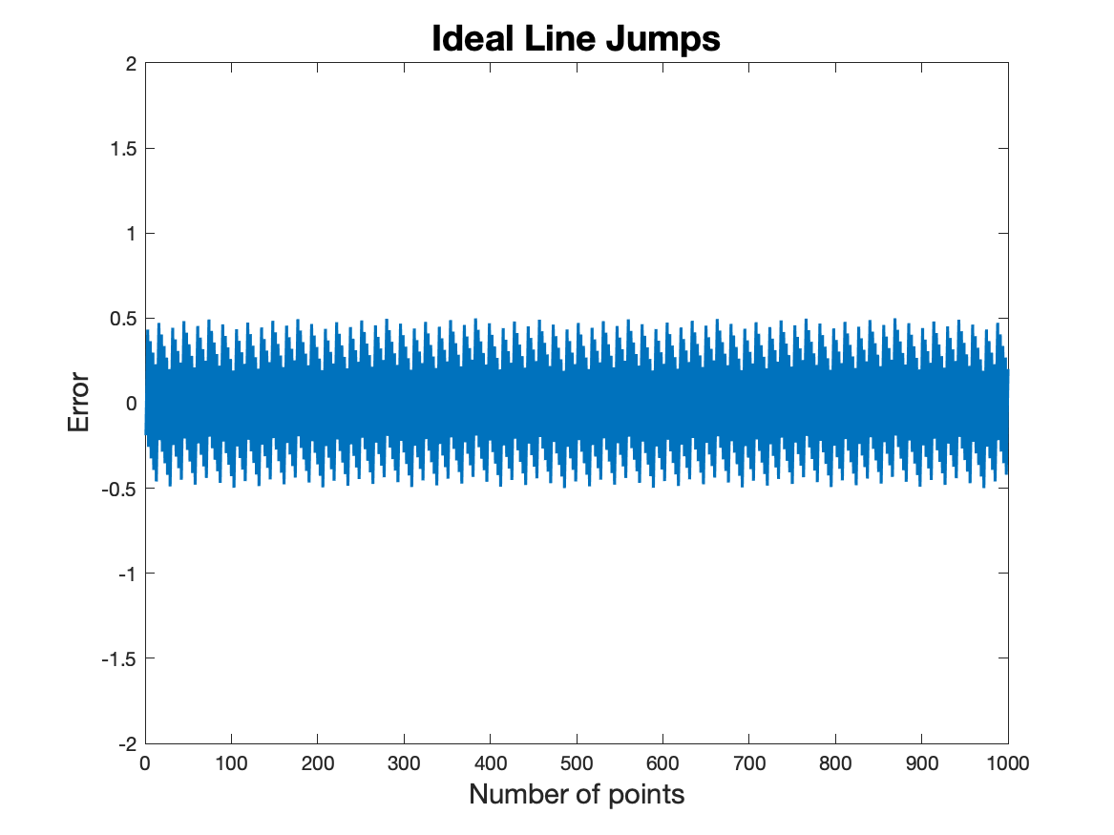
Results of Quantifying “Jaggedness”
For ideal case the jump is ± 0.5
Also, the max jump is also 0.5
Also, the sum of all jumps in all iterative cases is always 0

Slide 14
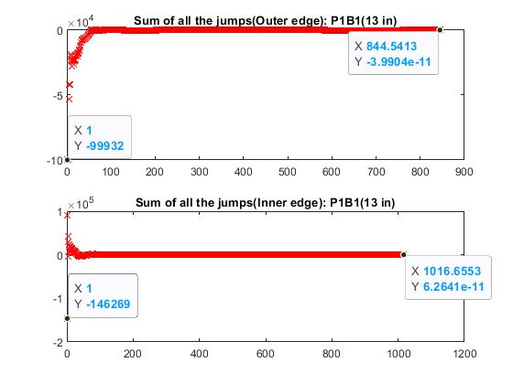
Results of Quantifying “Jaggedness”
Here, we sum up all the jumps for iterative line fitting and find that the summation of the jumps goes down to order of 10^(-11)
This shows us that the fit becomes very good as the length increases and the jumps add up to a very negligent value.

Slide 15
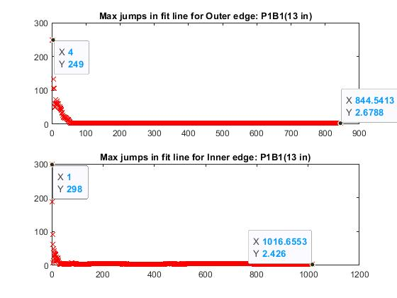
Results of Quantifying “Jaggedness”
Here, a line is fit iteratively through successive data points till we fit all pixel points and plot data points with maximum jumps through the iterative fits.
It is observed that the max jumps goes down as the line is fit through more data points successively.
Eg: Max jump goes from (4 data point fit, jump - 249 to 844.54 data point fit, jump - 2.68)

Slide 16
Insights
When all the points are line fit, the jumps in our sample case are around 5 times more than ideal line case. This could be related to the ratio of the angle error between the ideal case and our sample case.

Slide 17
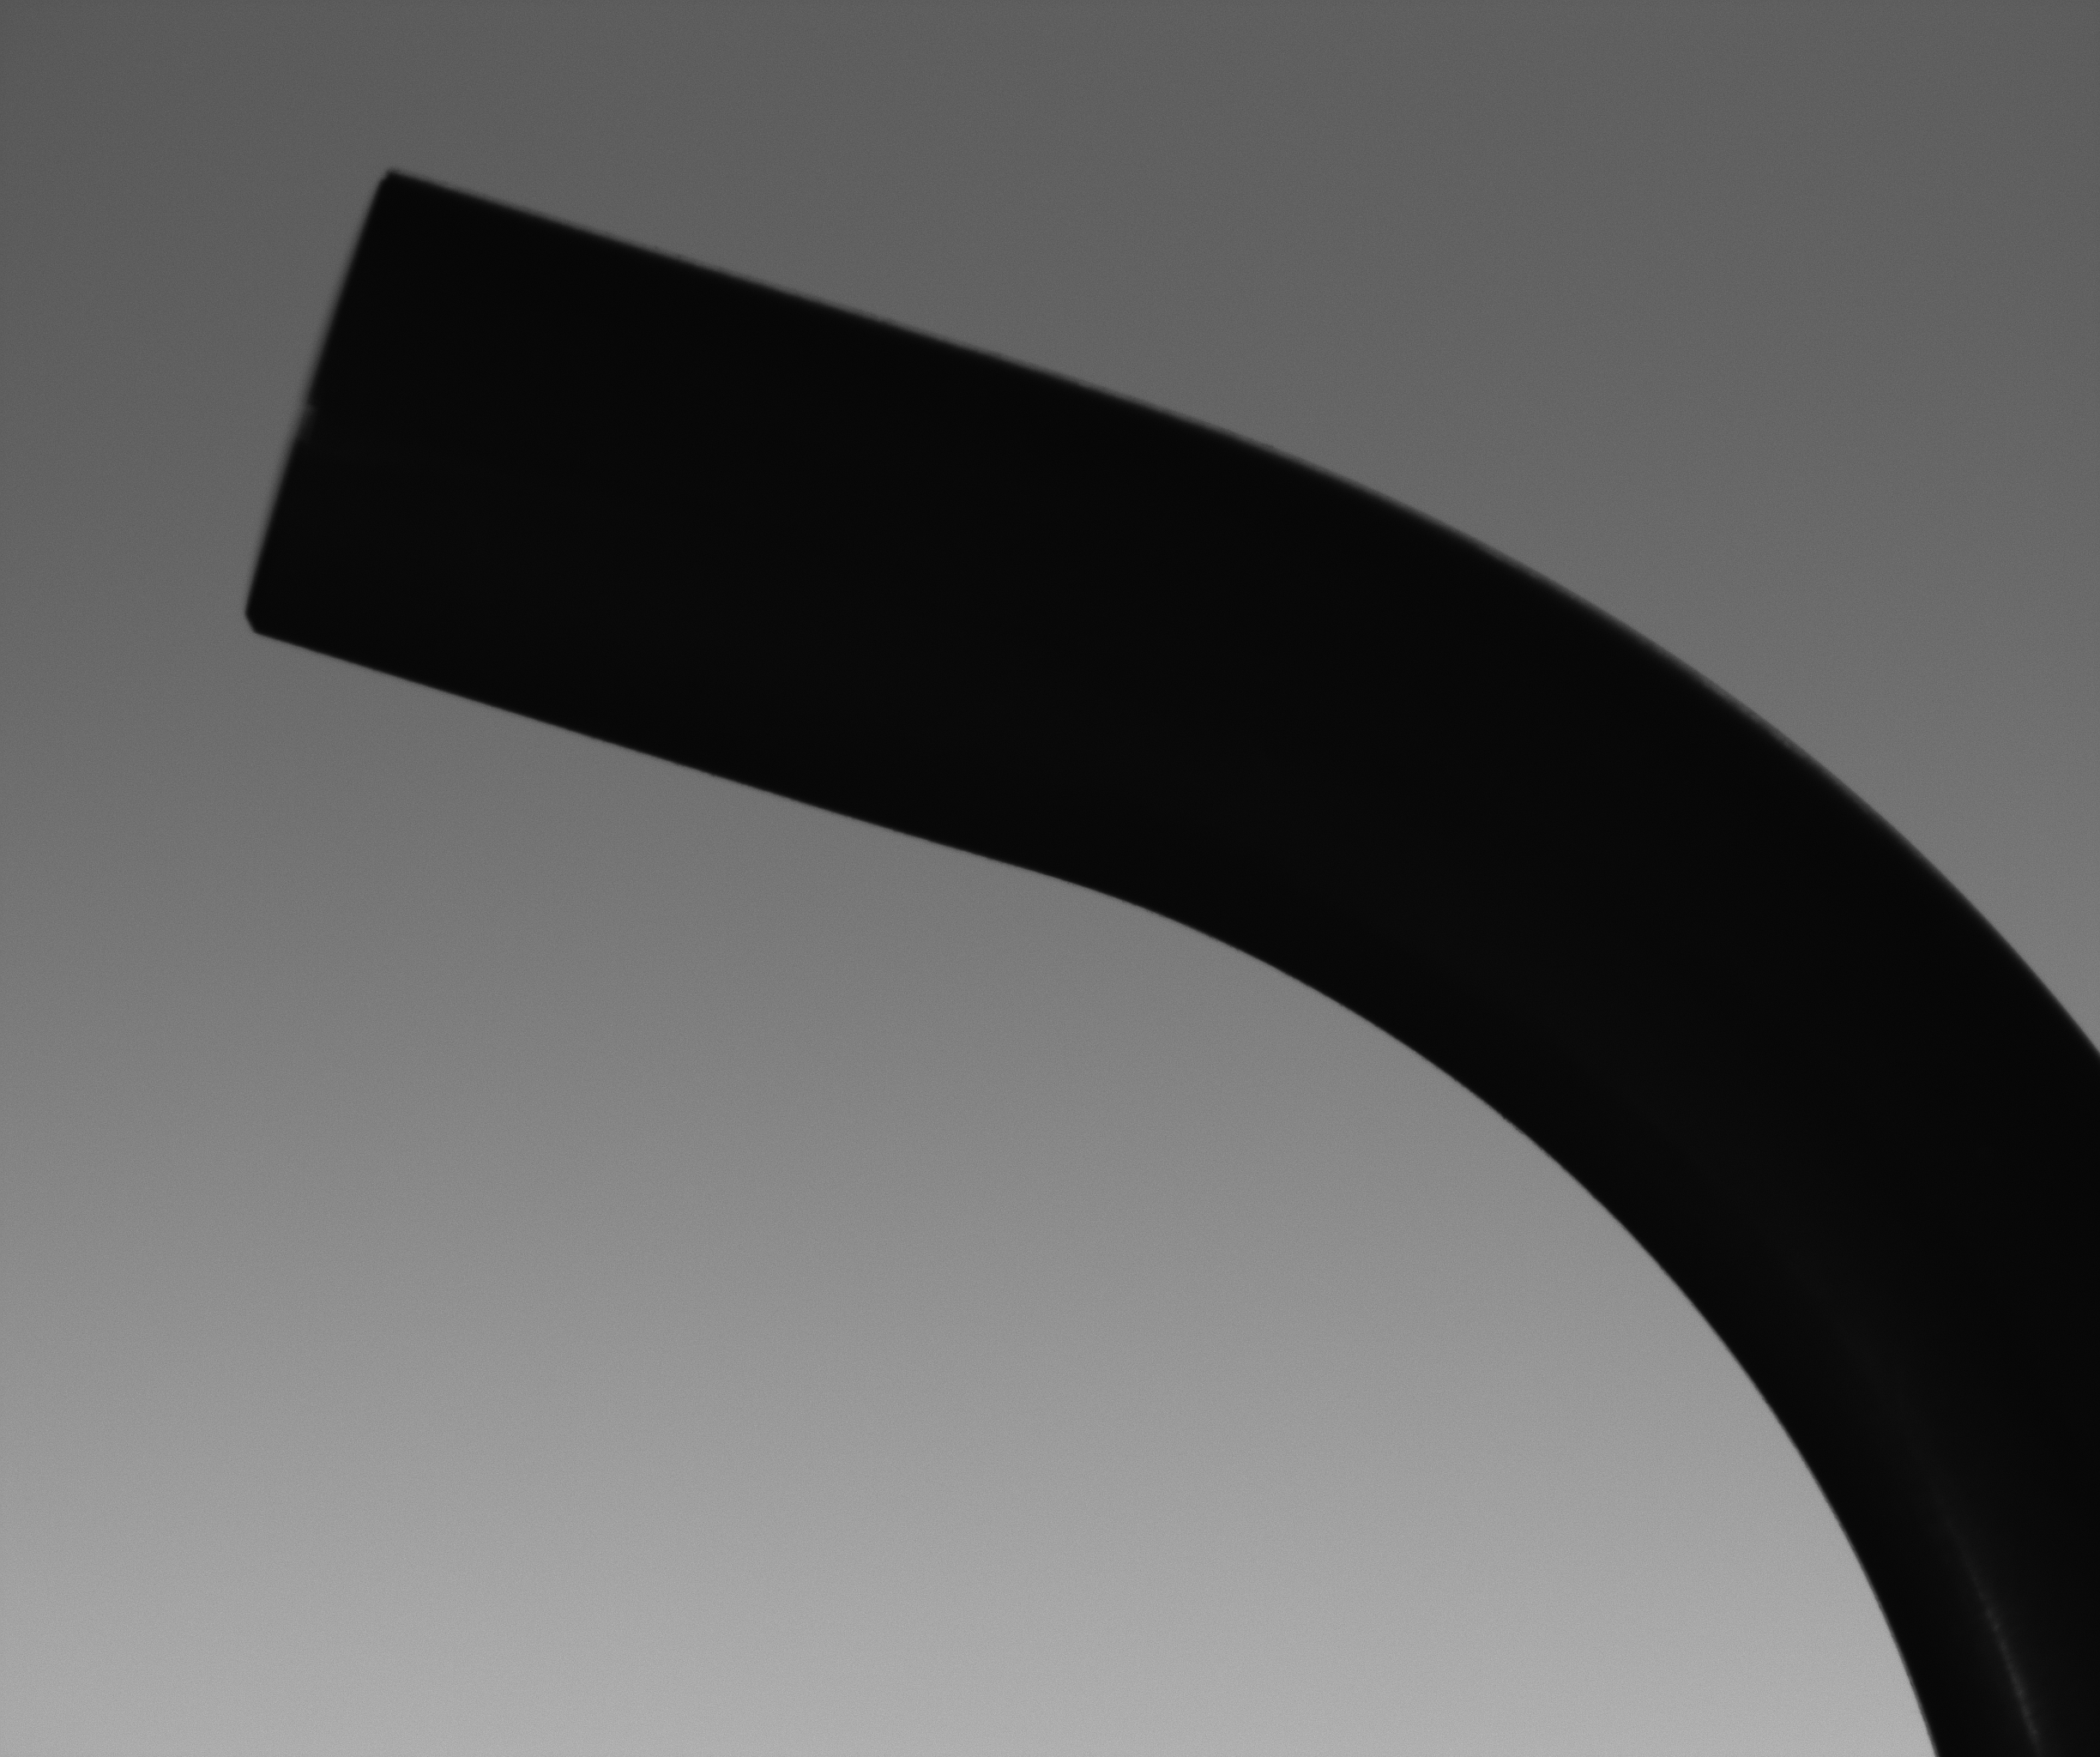
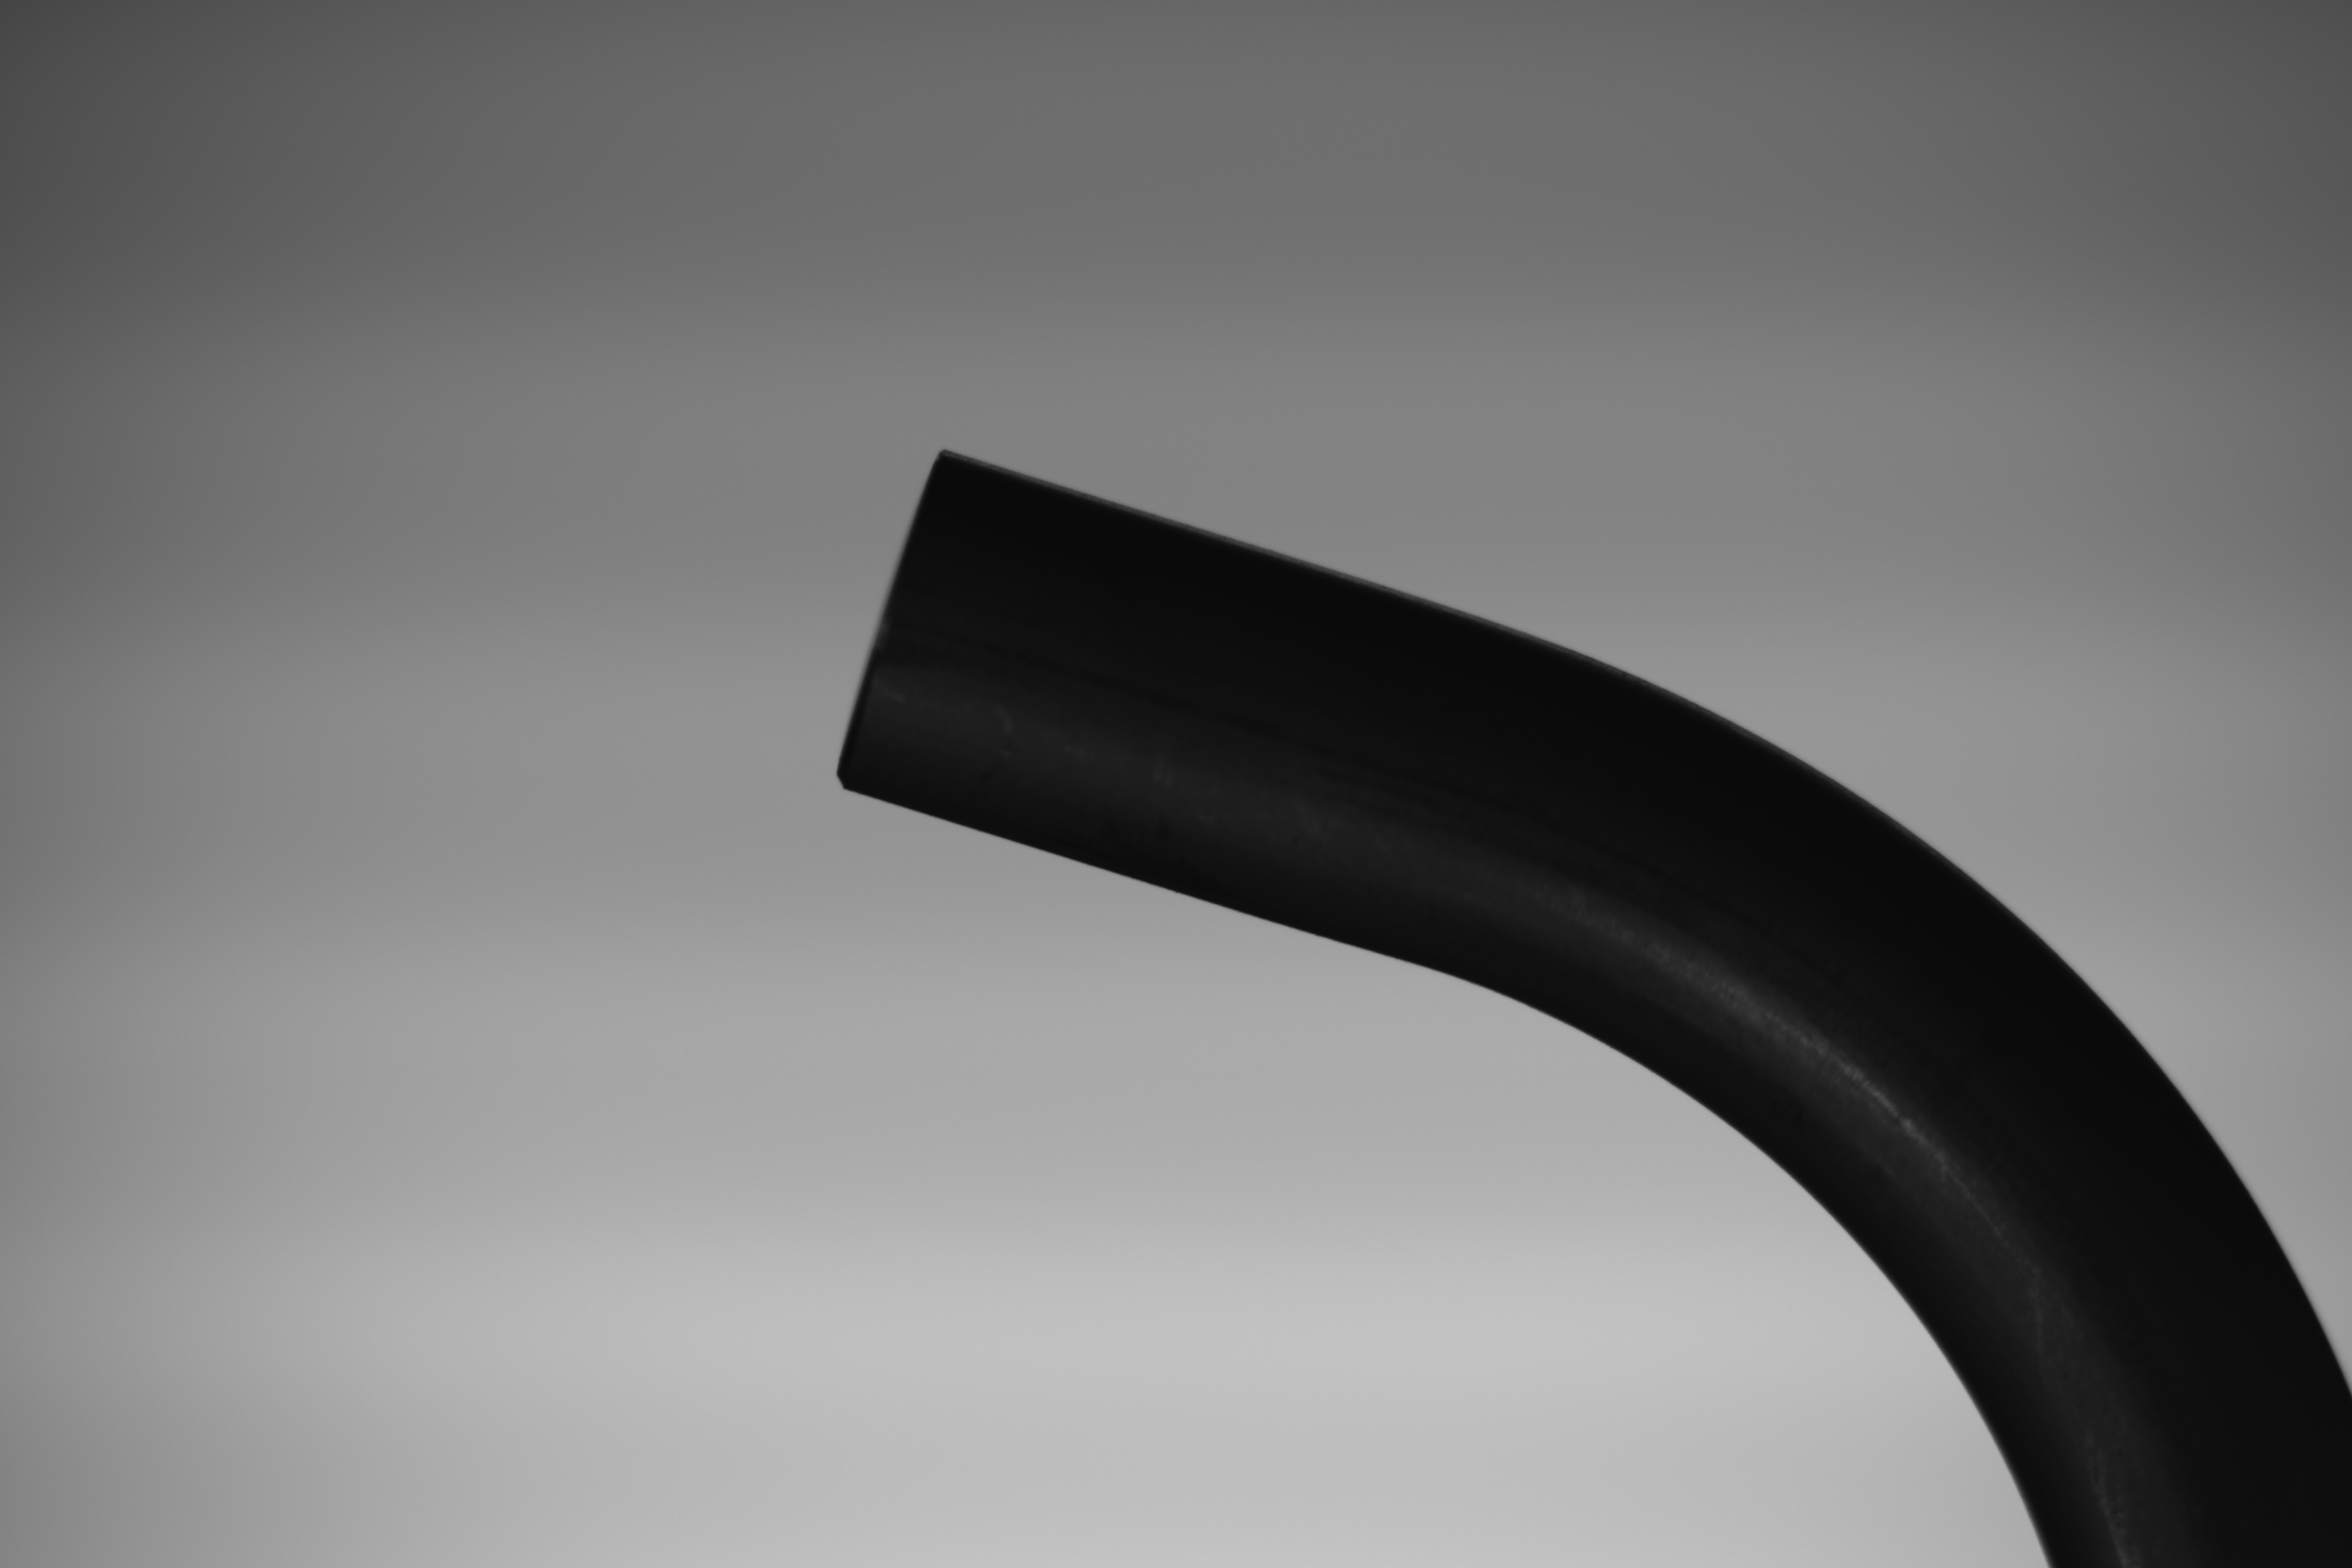
Differences between the 5MP and 20MP
Resolution: 2448 * 2048
1.11cm * 1.03cm
Resolution: 5472 * 3648
2.38cm * 2.22cm

Slide 18
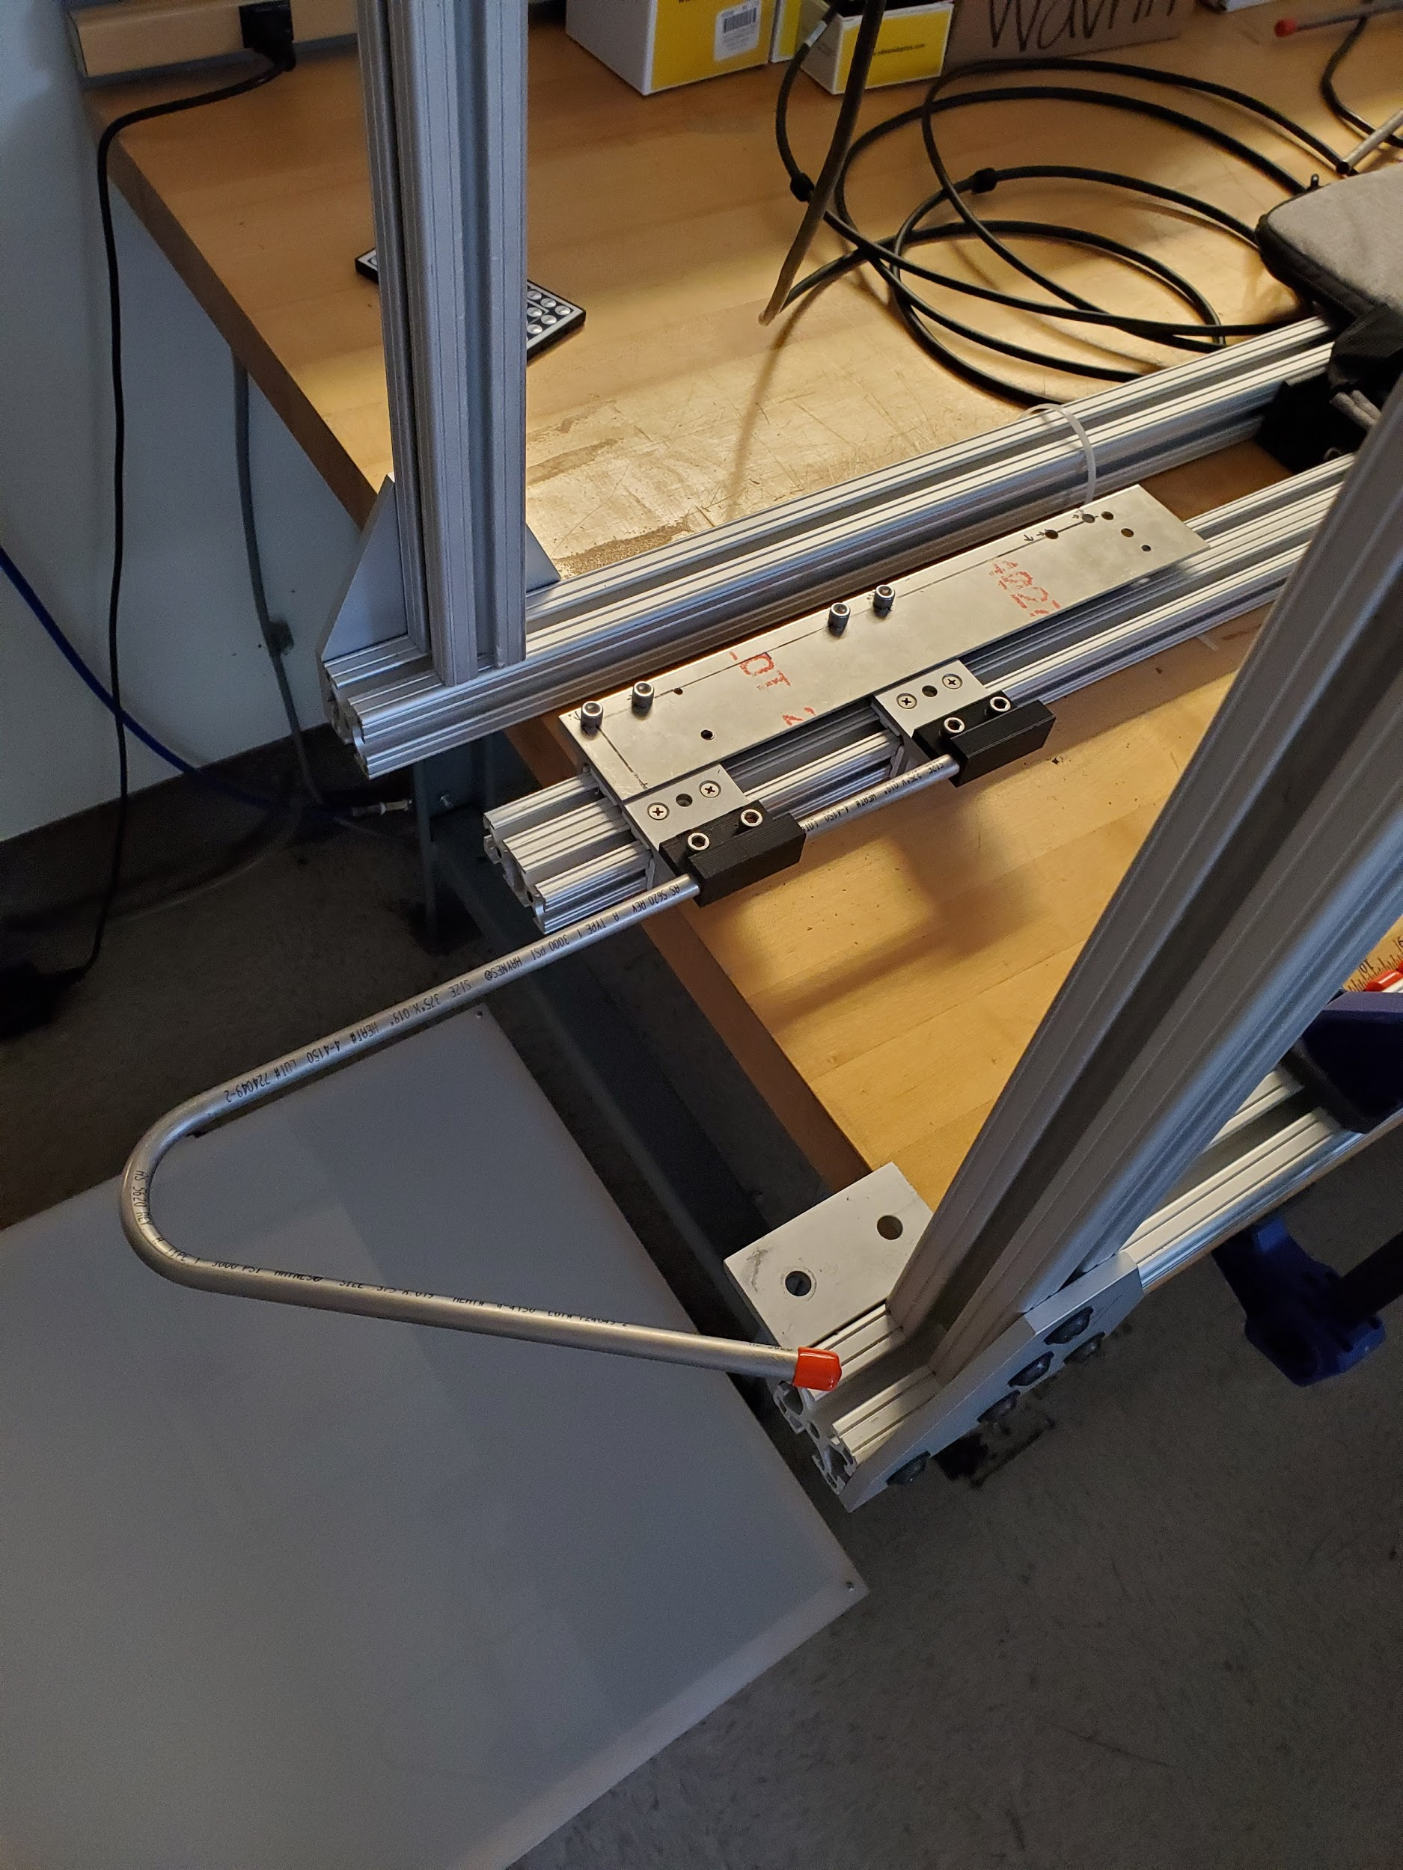
Comparison between 5MP and 20MP (angle Calculation)
 | Actual angle | Angle error for 5MP | Angle error for 20MP
Bend 1 | 20 | 0.2 | 0.2
Bend 5 | 100 | 0.3 | 0.02
Bend 6 | 120 | 0.25 | 0.01
Bend 7 | 140 | 0.25 | 0.05
Bend 8 | 160 | 0.25 | 0.12

Slide 19
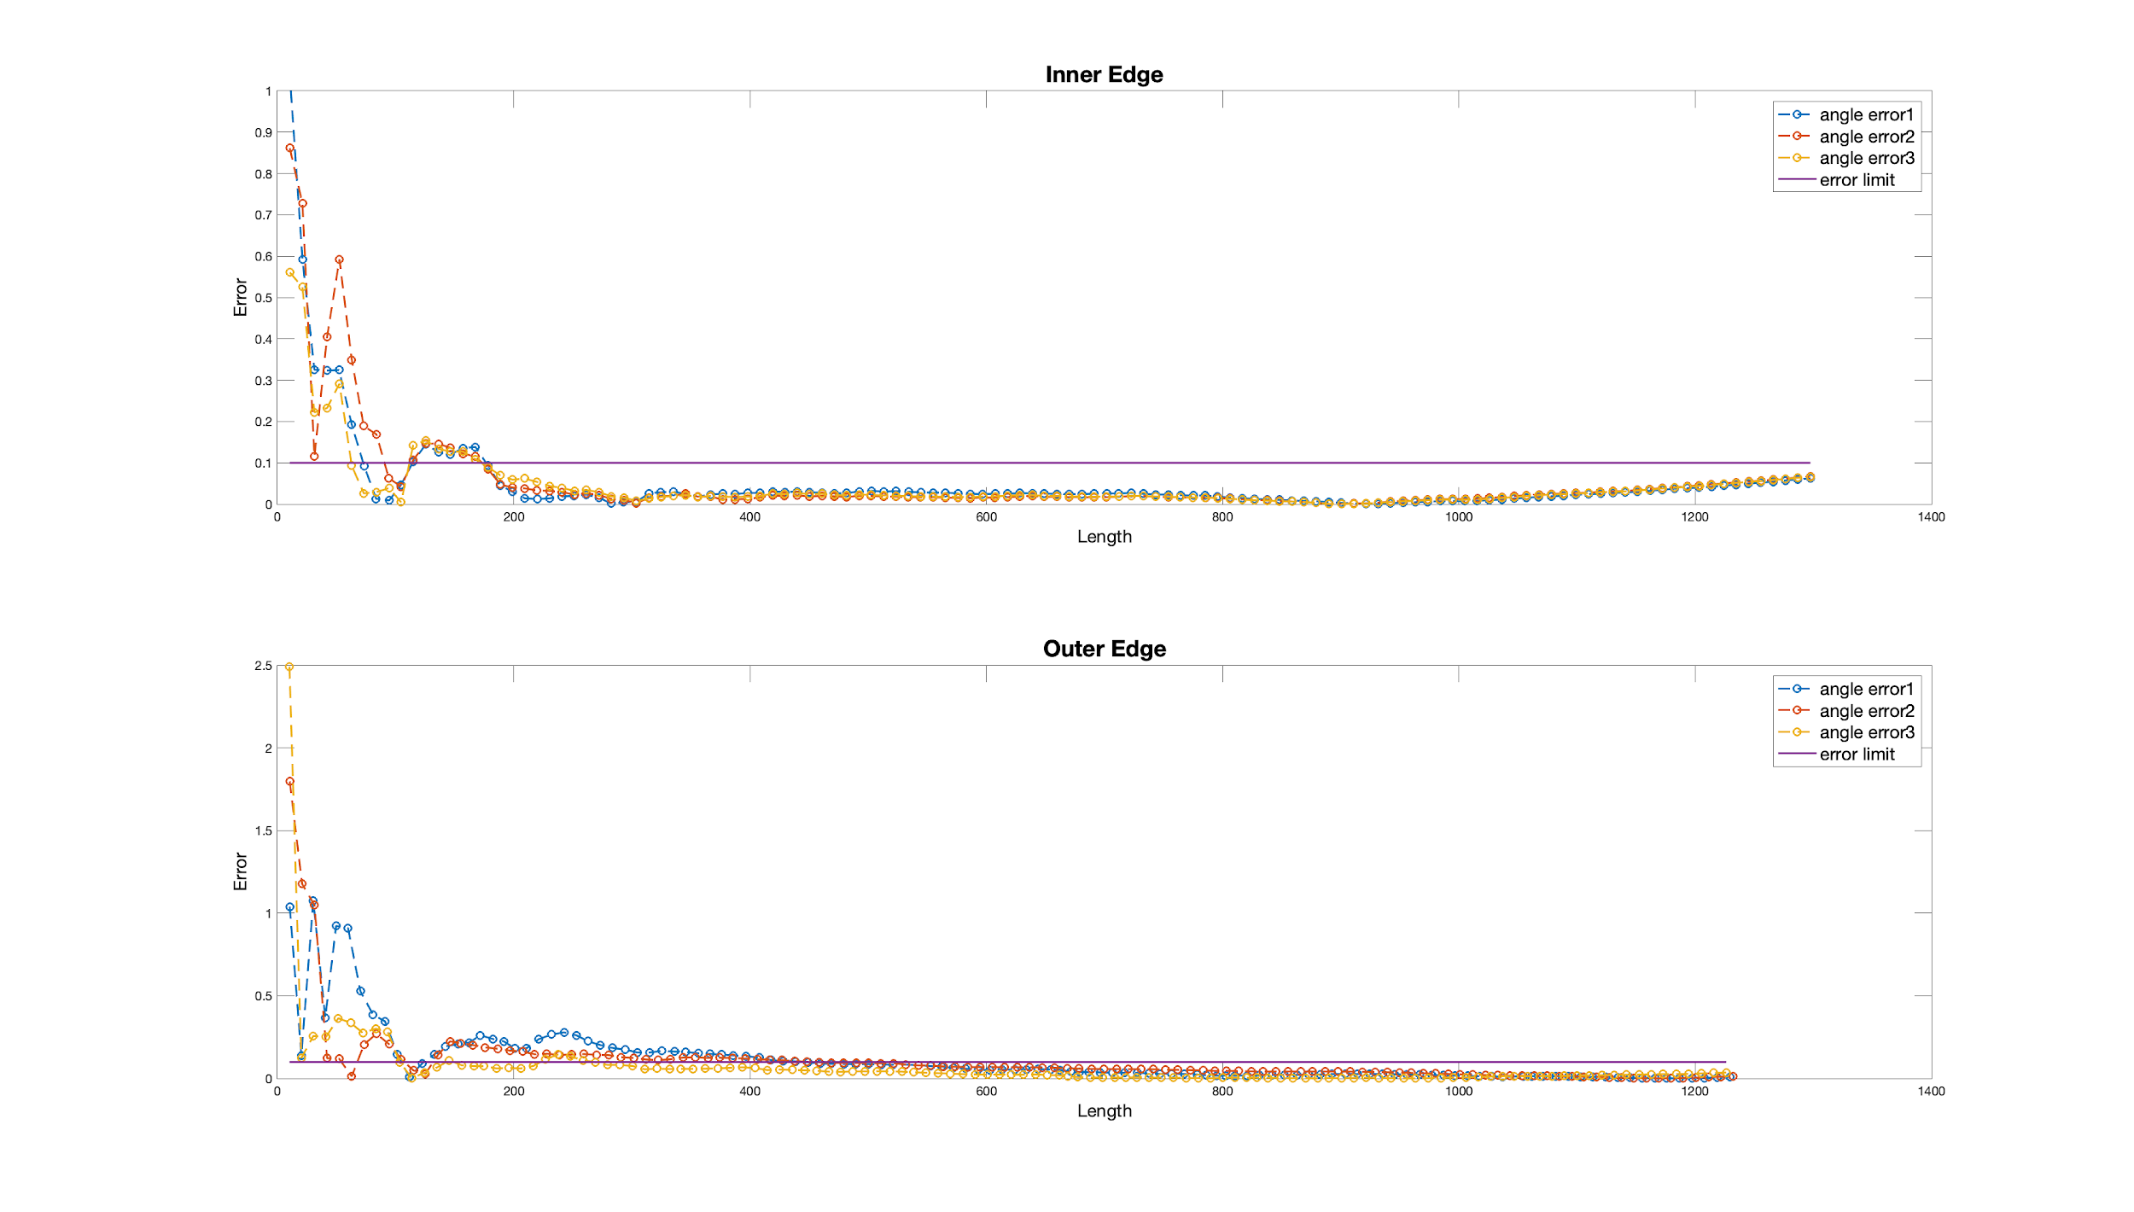
Results using 20MP Camera : P1B1
The max difference between the 3 cases (taking the images):
Inner edge: 0.0043
Outer edge: 0.0260

Slide 20
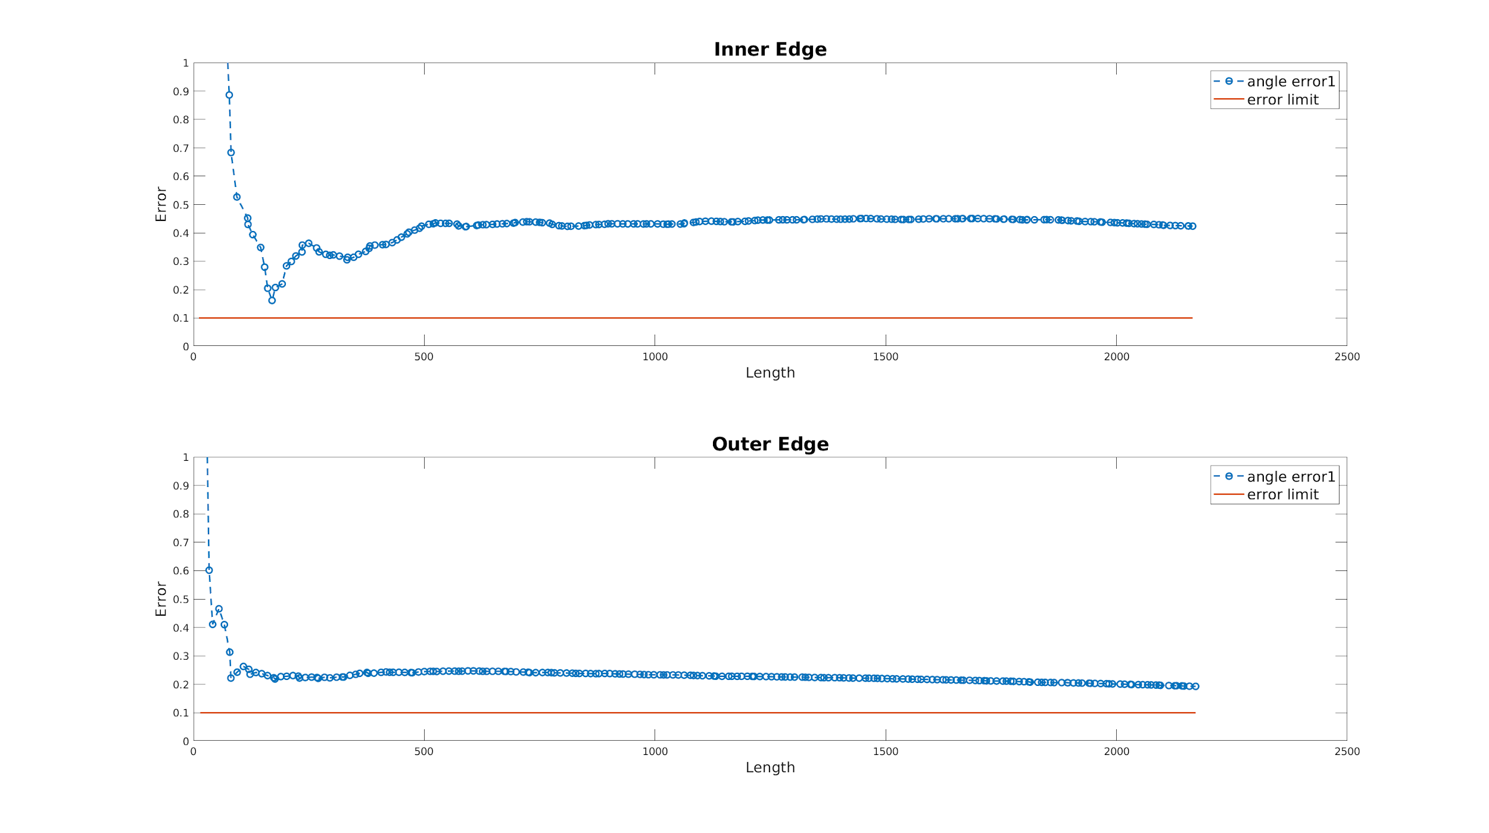
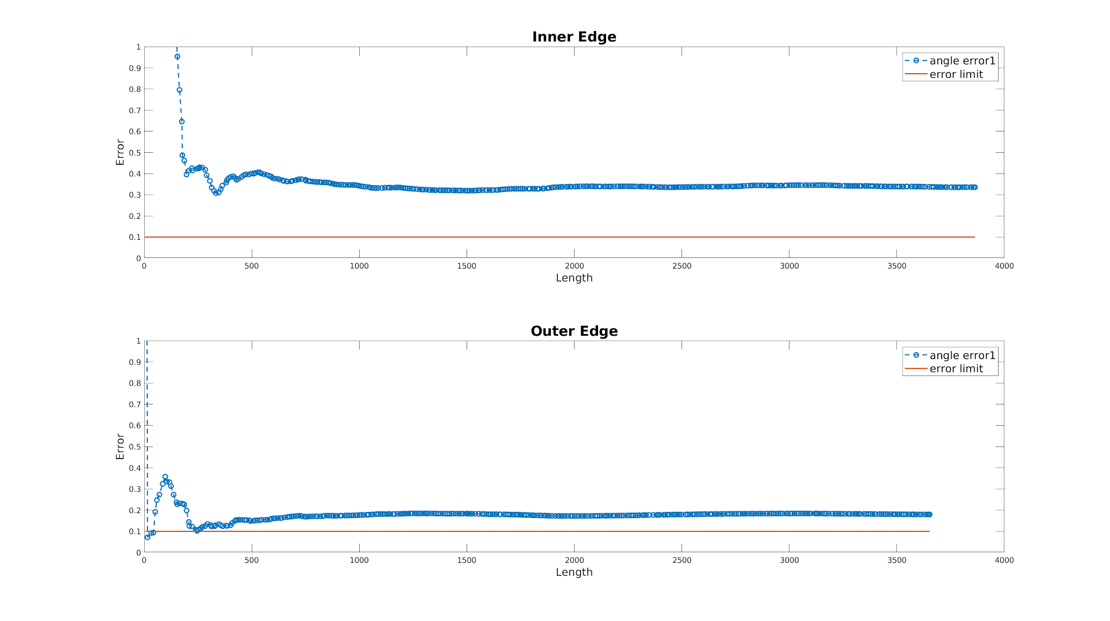
Results for 20 degrees
5MP Camera
Error: 0.2
20MP Camera
Error: 0.2

Slide 21
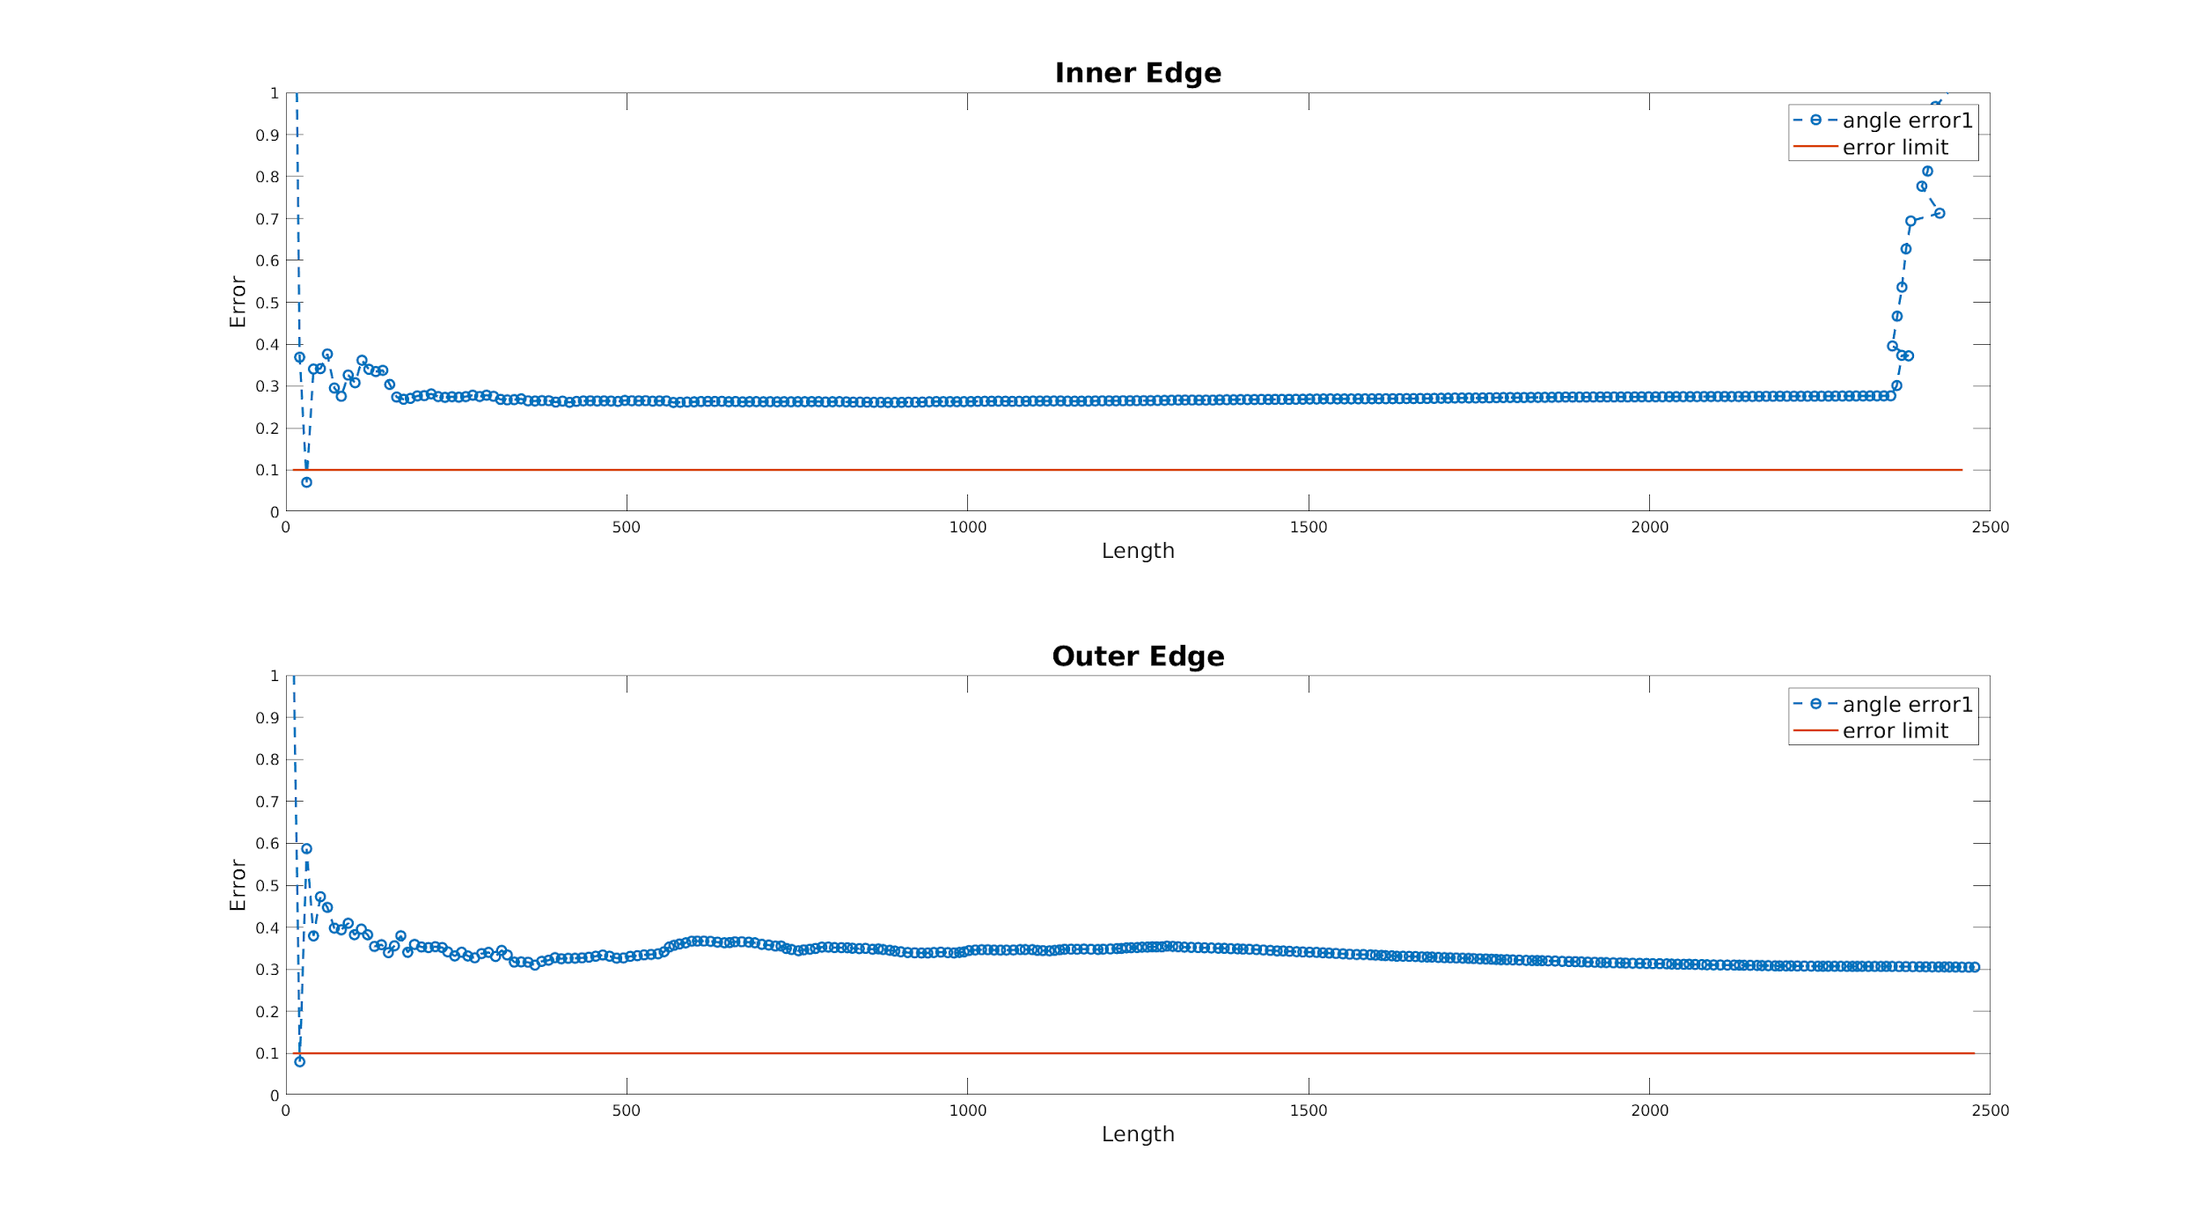
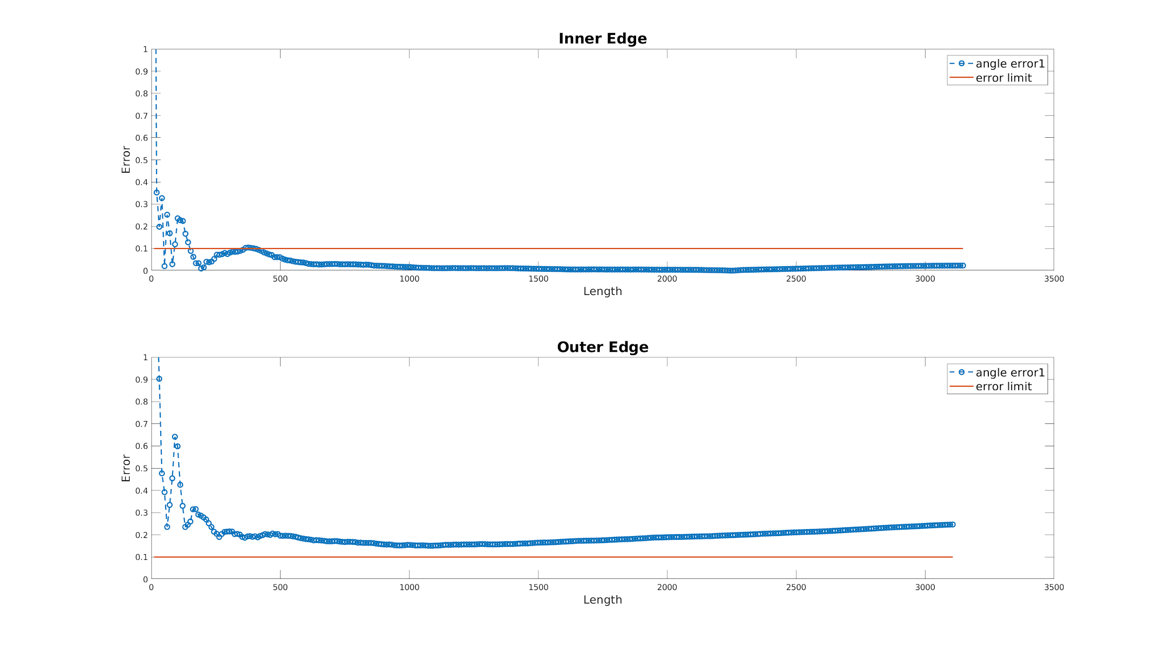
Results for 100 degrees
5MP Camera
Error: 0.3
20MP Camera
Error: 0.02

Slide 22
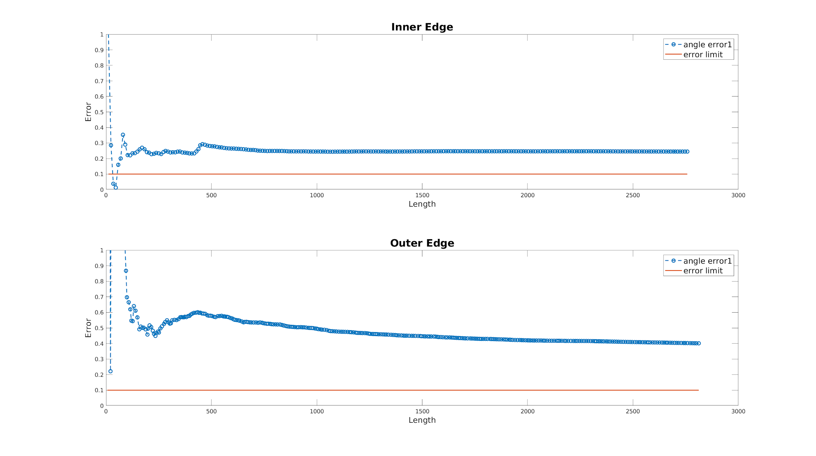
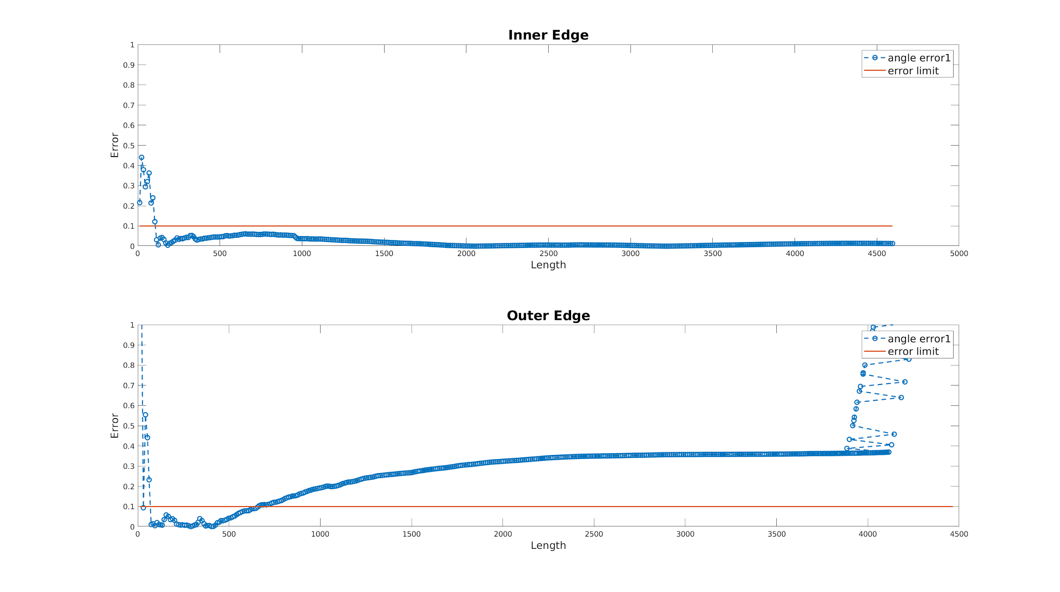
Results for 120 degrees
5MP Camera
Error: 0.2
20MP Camera
Error: 0.01

Slide 23
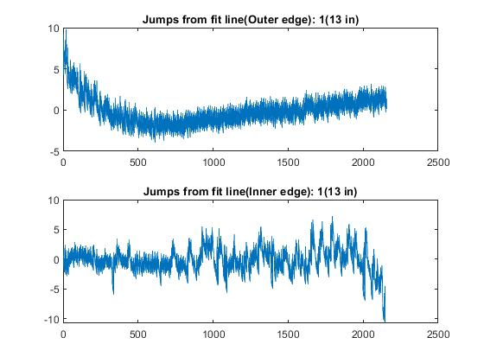
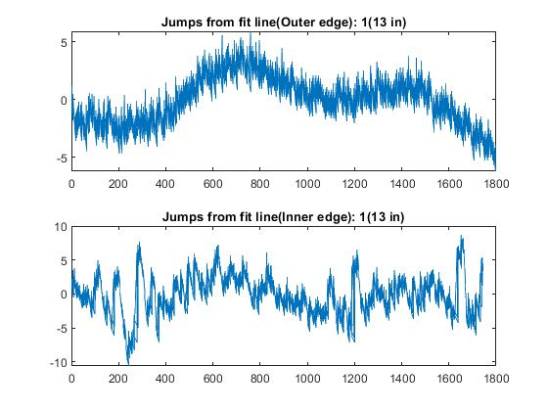
Jaggedness in planar bend 1
2K
4K

Slide 24
Future work
Capture images of bends at different heights using the two cameras
Compare results and quantify no. of points.

